Slide 1

File System Review
Computer System Engineering, Fall 2019. (IPADS, SJTU)
Where are we now
Yubin Xia

Slide 2
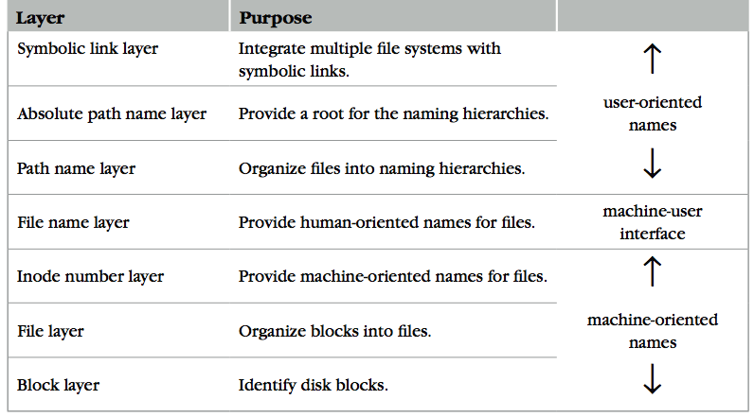
The Naming Layers of the UNIX FS (version 6)

Slide 3
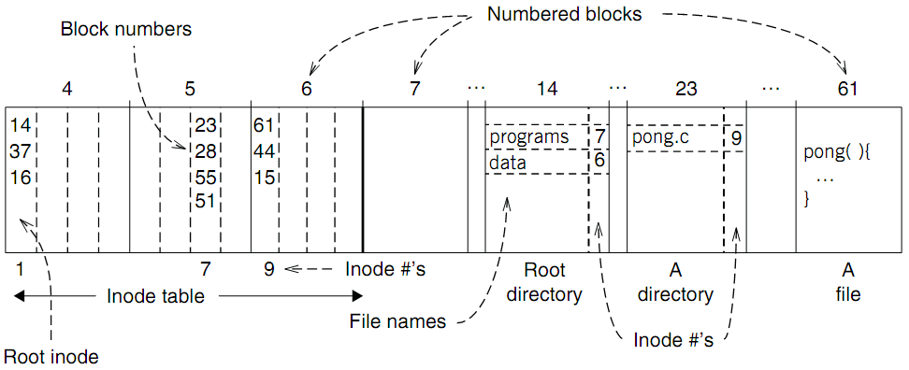
An Example: Find Blocks of "/programs/pong.c"

Slide 4
Two Types of Links (Synonyms)
Add link "assignment" to "Mail/new-assignment"
Hard link
No new file is created
Just add a binding between a string and an existing inode
Target inode reference count is increased
If target file is deleted, the link is still valid
Soft link
A new file is created, the data is the string "Mail/new-assignment"
Target inode reference count is not increased
If target file is deleted, the link is not valid
Soft link can create cycle by SYMLINK("a", "a")
Notes:
Here comes a demo~

Slide 5
FAT File System
File allocation table (FAT)
Organize files as linked lists
No inode
File metadata: name & size
Metadata are saved in dirs
Root dir at sector 0
Link? Permission?

Slide 6
FAT (File Allocation Table) File System
File is collection of disk blocks
FAT is linked list 1-1 with blocks
File Number is index of root of block list for the file
File offset (o = < B, x > )
Follow list to get block #
Unused blocks ⬄ FAT free list
FAT
Disk Blocks
file number
0:
0:
31:
File 31, Block 0
File 31, Block 1
free
File 31, Block 2
N-1:
N-1:
memory

Slide 7
File Cursor Sharing
Note: this refcnt is not the refcnt of inode!
fd_table
file_table
fd
index
index
inode num
file cursor
refcnt
Process A
3
115
115
23
128
1
116
23
240
2
fd
index
Process B
3
116
...
fd
index
C is B's child
3
116
Process A, B and C all open just one file with inode number 23
Process A and B open the same file, not share file cursor
Process B and C share the file cursor

Slide 8
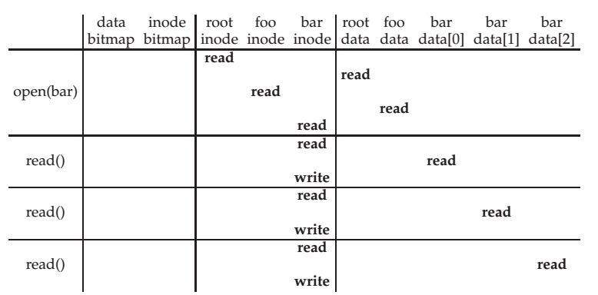
File Open & Read Timeline
open("/foo/bar", O_RDONLY)
Why "write" on bar inode in a read operation? Why no "write" on foo inodes?

Slide 9
Layers: One Deeper Futher

Slide 10
IDE Disk Driver using PIO
Address 0x1F0 = Data Port
Address 0x1F1 = Error
Address 0x1F2 = Sector Count
Address 0x1F3 = LBA low byte
Address 0x1F4 = LBA mid byte
Address 0x1F5 = LBA hi byte
Address 0x1F6 = 1B1D TOP4LBA: B=LBA, D=drive
Address 0x1F7 = Command/status
static int ide_wait_ready() {
while (((int r = inb(0x1f7)) & IDE_BSY) || !(r & IDE_DRDY))
; // loop until drive isn't busy
}
static void ide_start_request(struct buf *b) {
ide_wait_ready();
outb(0x3f6, 0); // generate interrupt
outb(0x1f2, 1); // how many sectors?
outb(0x1f3, b->sector & 0xff); // Block address here ...
outb(0x1f4, (b->sector >> 8) & 0xff); // ... and here
outb(0x1f5, (b->sector >> 16) & 0xff); // ... and here!
outb(0x1f6, 0xe0 | ((b->dev&1)<<4) | ((b->sector>>24)&0x0f));
if(b->flags & B_DIRTY){
outb(0x1f7, IDE_CMD_WRITE); // this is a WRITE
outsl(0x1f0, b->data, 512/4); // transfer data too!
} else {
outb(0x1f7, IDE_CMD_READ); // this is a READ (no data)
}
}
Status
Register
(0x1F7):
7: BUSY
6: READY
5: FAULT
4: SEEK
3: DRQ
2: CORR
1: IDDEX
0: ERROR
Error
Register
(0x1F1):
7: BBK
6: UNC
5: MC
4: IDNF
3: MCR
2: ABRT
1: T0NF
0: AMNF
BBK = Bad Block
UNC = Uncorrectable data error
MC = Media Changed
IDNF = ID mark Not Found
MCR = Media Change Requested
ABRT = Command aborted
T0NF = Track 0 Not Found
AMNF = Address Mark Not Found

Slide 11
BUS: a hardware layer

Slide 12
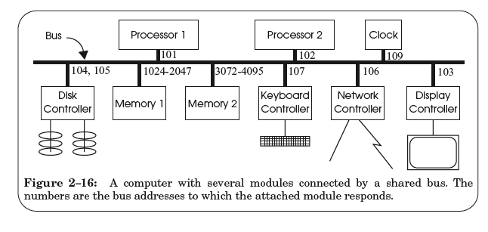
A Hardware Layer: the Bus

Slide 13
Bus Features
A set of wires
Comprising address, data, control lines that connect to a bus interface on each module
Broadcast link
Every module hears every message
Bus address: identify the intended recipient, as the name
Bus arbitration protocol
Decide which module may send or receive message at any particular time
Bus arbiter (optional): a circuit to choose which modules can use the bus

Slide 14
Bus Transaction
Source module requires exclusive use of the bus: the data sender
Source module places a bus address of the destine module on the bus
Source module signals READY wire to alert the other module
The destine module singles ACKNOWLEDGE wire after copied the data
If synchronized, then READY & ACKNOWLEDGE are not needed, just need to check the address lines on each clock cycle
Source module releases the bus

Slide 15
Memory Load Example: LOAD 1742, R1
Processor #2 => all bus modules: {1742, READ, 102}

Slide 16
Memory Load Example: LOAD 1742, R1
Memory 1 recognizes the address is within its range
By examining just a few high-order address bits

Slide 17
Memory Load Example: LOAD 1742, R1
Memory 1 acknowledges and processor 2 releases the bus
Memory 1 performs the internal operation to get the value
value <- READ (1742)

Slide 18
Memory Load Example: LOAD 1742, R1
Memory1 => all bus modules: {102, value}

Slide 19
Memory Load Example: LOAD 1742, R1
Processor 2 is waiting for this result, just copies the data on the bus to its register R1

Slide 20
Memory Load Example: LOAD 1742, R1
Processor 2 acknowledges and memory 1 releases the bus

Slide 21
Sync VS. Async
Sync data transfer
Source & destination cooperate through a shared clock
Async data transfer
Source and destination cooperate through explicit signal line
E.g., acknowledge line

Slide 22
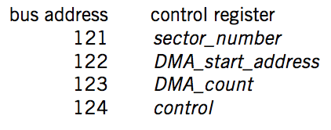
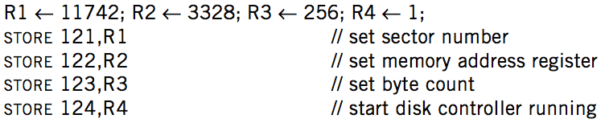

DMA on Bus

Slide 23
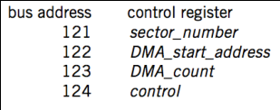
DMA Example
Processor 1
Processor 2
101
102
256-511
3072-4095
121-124
BIOS
Memory
Disk
Processor #1 => all bus modules: {121, WRITE, 11742}
Disk acknowledge and write the value 11742 to its control register
Processor #1 => all bus modules: {122, WRITE, 3328}
Processor #1 => all bus modules: {123, WRITE, 256}
Processor #1 => all bus modules: {124, WRITE, 1}

Slide 24
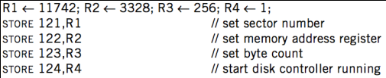
DMA Example
Processor 1
Processor 2
101
102
256-511
3072-4095
121-124
BIOS
Memory
Disk
Disk => all bus modules: {3328, WRITE, data[11742]}
Memory acknowledge and save data[11742]
Disk => all bus modules: {3329, WRITE, data[11743]}
... (loop)
Disk => all bus modules: {3583, WRITE, data[11997]}

Slide 25
DMA Example
Processor 1
Processor 2
101
102
256-511
3072-4095
121-124
BIOS
Memory
Disk
When transferring is finished, disk controller SENDs message to the processor
Just like keyboard controller does when press a key
Processor will enter interrupt handler next cycle
Now the processor knows that the DMA is done

Slide 26
Summary

Slide 27
Summary
CPU interacts with physical memory
Through system bus that connects each other
Using physical address to name memory content
CPU interacts with a device
Also using physical address (aka., bus address)
Polling, interrupt and DMA
I/O instruction (PIO) or MMIO

Slide 28
Summary
Memory Load/Store
Between CPU and memory
Physical memory address space
I/O Operations
MMIO: map device memory and registers into physical address space
DMA
Also using physical address
Processor
PIO (in/out)
/MMIO (load/store)
load/store
Memory
DMA
I/O Device

Slide 29
Questions
Q: How are the physical addresses assigned?
Memory physical addresses: by BIOS
Some devices (e.g., keyboard, IDE): fixed for all time
Other devices: assigned by the OS

Slide 30
Questions
Q: Why not map the whole disk to memory?
So that the CPU can access a byte on the disk directly by system bus
1. Too large
2. Too slow
The principle of least astonishment:
People are part of the system. The design should match the user's experience, expectations, and mental models
Q: now Intel's 3D-xpoint is 512GB memory, why disk?

Slide 31
Crash Consistency

Slide 32
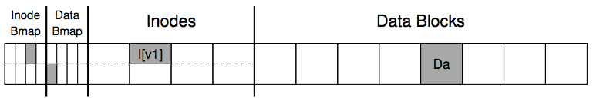
An Example: Append a File
Inside of I[v1]:
owner : yubin
permissions : read-only
size : 1
pointer : 4
pointer : null
pointer : null
pointer : null
Inside of I[v2]:
owner : yubin
permissions : read-only
size : 2
pointer : 4
pointer : 5
pointer : null
pointer : null

Slide 33
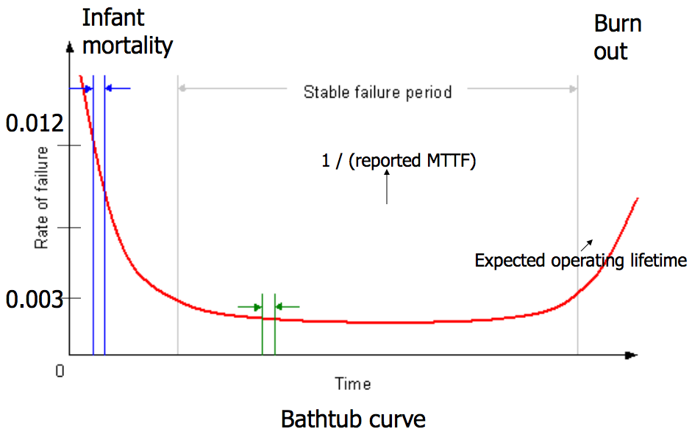
Bathtub Curve
gross manufacturing defects
run for a while before shipping
accumulated ware and tear cause failure

Slide 34
Availability
Counting the number of nines
E.g. 99.9% has 3-nines availability
Often used in marketing
Corresponding down time
E.g. 3-nines -> 8 hour/year
E.g. 5-nines -> 5 min/year
E.g. 7-nines -> 3 sec/year
Without any information about MTTF
More fine-grained
Fail-soft, as in 8.3

Slide 35
Systematically Applying Redundancy
Masking error
Analog system designer: margin
Digital system designer: redundancy
Outline
Coding: incremental redundancy
Replication: massive redundancy
Voting
Repair

Slide 36
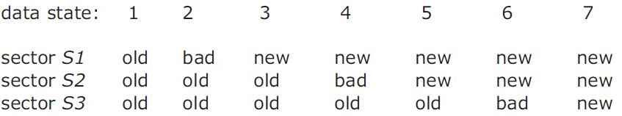
ALL_OR_NOTHING_PUT
if (data1 = data2) and (data2 = data3) return // State 1 or 7, no repair
if (data1 = data2)
CAREFUL_PUT (data1, all_or_nothing_sector.S3) return // State 5 or 6.
if (data2 = data3)
CAREFUL_PUT (data2, all_or_nothing_sector.S1) return // State 2 or 3.
CAREFUL_PUT (data1, all_or_nothing_sector.S2) // State 4, go to state 5
CAREFUL_PUT (data1, all_or_nothing_sector.S3 // State 5, go to state 7
Notes:
The choice of which to use is arbitrary; as shown the procedure copies the new value in sector S1 to both sectors S2 and S3.

Slide 37
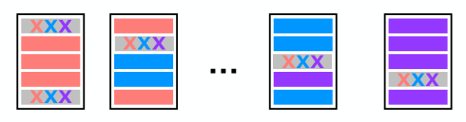
RAID 5 (Spread Out the Parity)
Can recover from single-disk failure
Requires N+1 disks (not 2N)
Better performance if stripe a single file across multiple data disks
Writes are spread across disks

Slide 38
Recovering FS Metadata from Crash
1. Synchronous meta-data update + fsck
During check, synchronize metadata, such as file size
2. Soft update (FreeBSD fs modified on FFS)
not covered in this course
3. Logging (ext 3/4), xv6-rev6 and following versions
Before doing actual meta-data update, log the event
After crash, recover from log

Slide 39
Problem of fsck: Too Slow
How long would fsck take?
an example server: fsck takes 10 minutes per 70GB disk w/ 2 million inodes
clearly reading many inodes sequentially, not seeking
still a long time, probably linear in disk size
Consider the example before:
Scan the disk for only three disk block writes
Just like find a key by searching the entire house

Slide 40
Barrier: Flush the Disk
Disk's write buffer
Disk will inform the OS the write is complete when it simply has been placed in the disk's memory cache
But the data is not on disk yet! No durability! No order!
One solution: disable the buffer
Another solution: using flush operation
Force the disk to write data to disk media
Aka., disk write barrier
However, disks may not do as they claim…
Some disks just ignore the flush operation to be faster
"the fast almost always beats out the slow, even if it is wrong" --- Kahan

Slide 41
Logging / Journaling

Slide 42
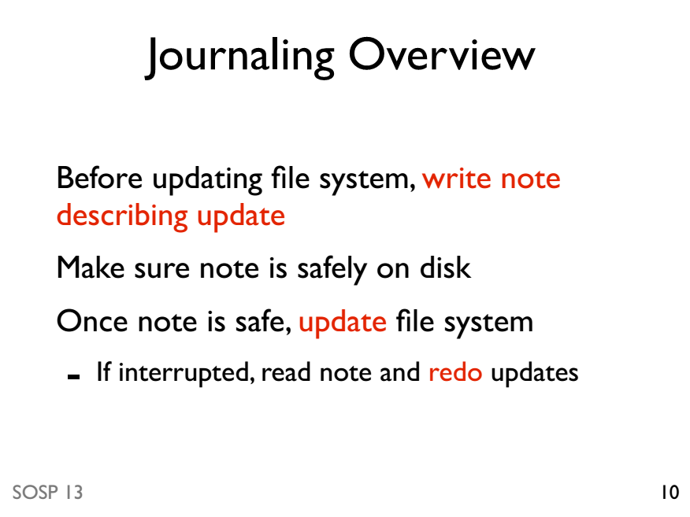

Slide 43
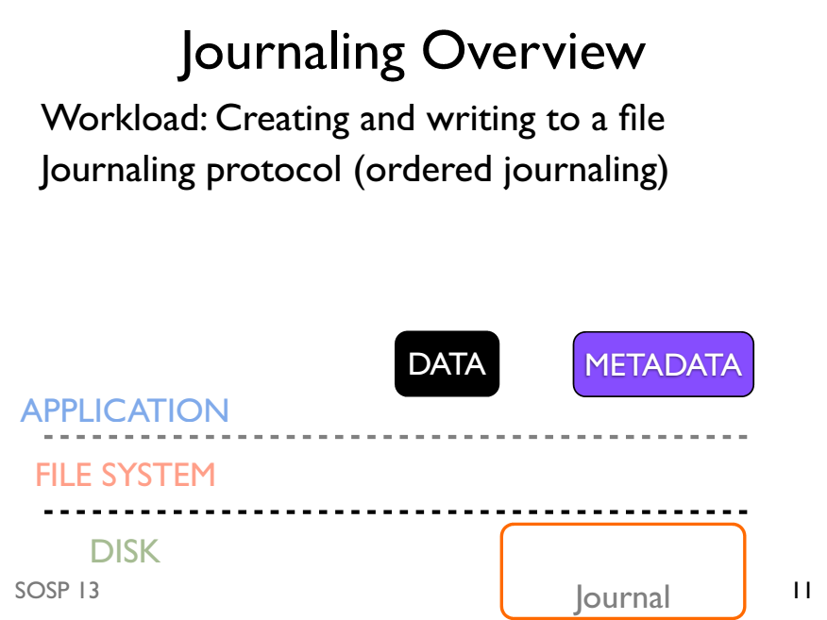

Slide 44
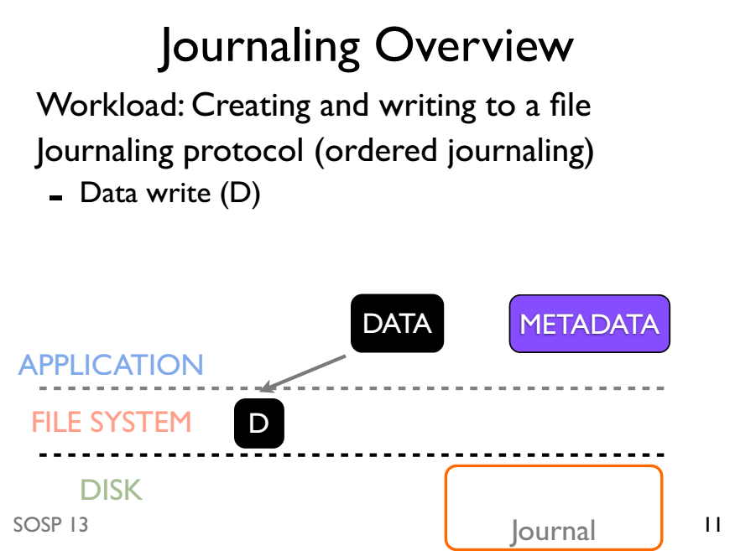

Slide 45
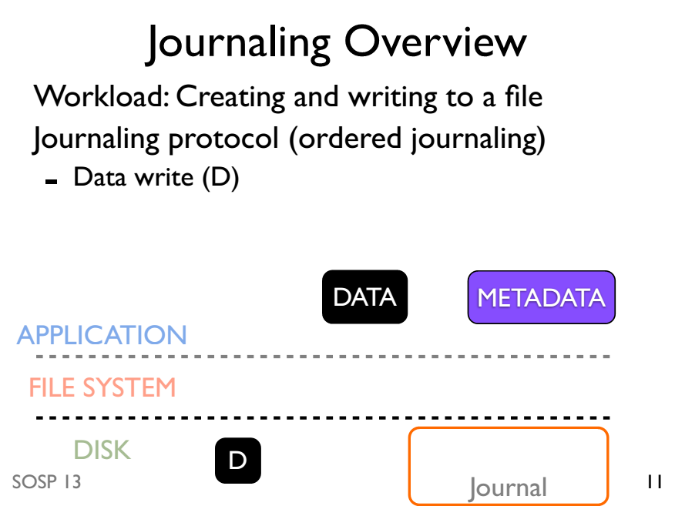

Slide 46
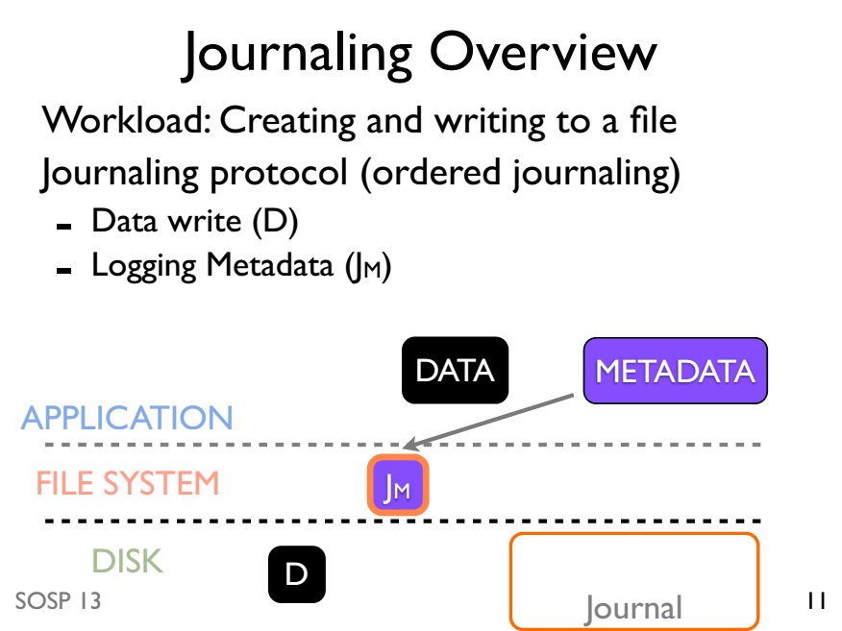

Slide 47
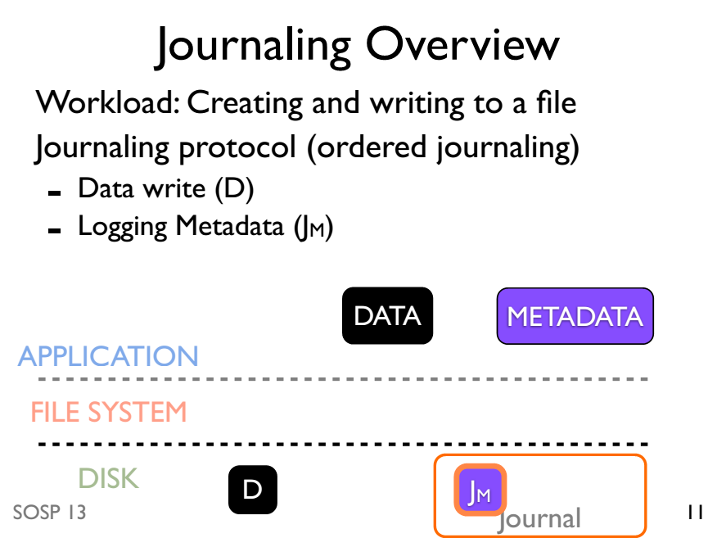

Slide 48
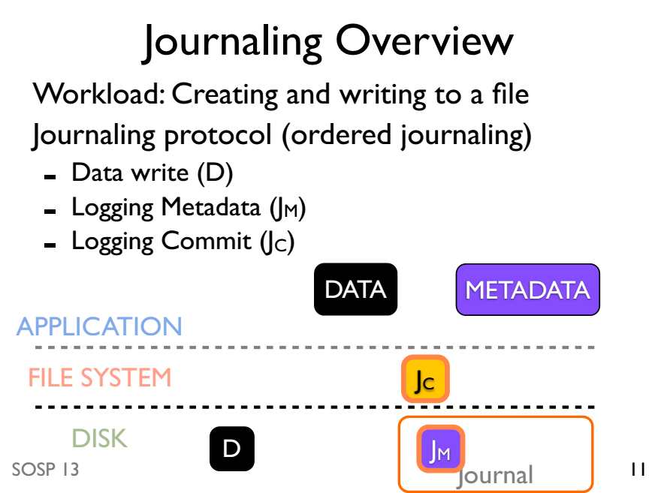

Slide 49
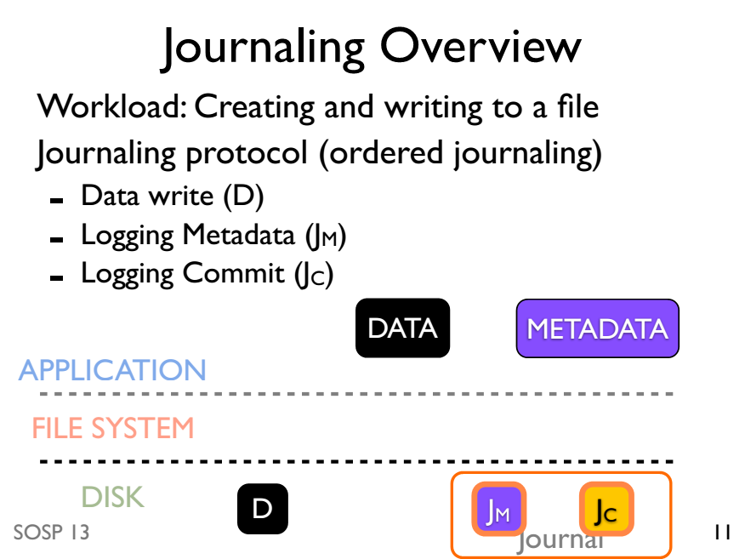

Slide 50
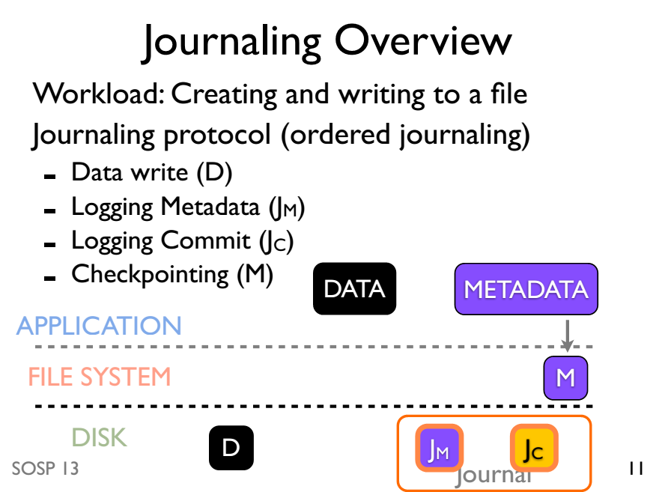

Slide 51
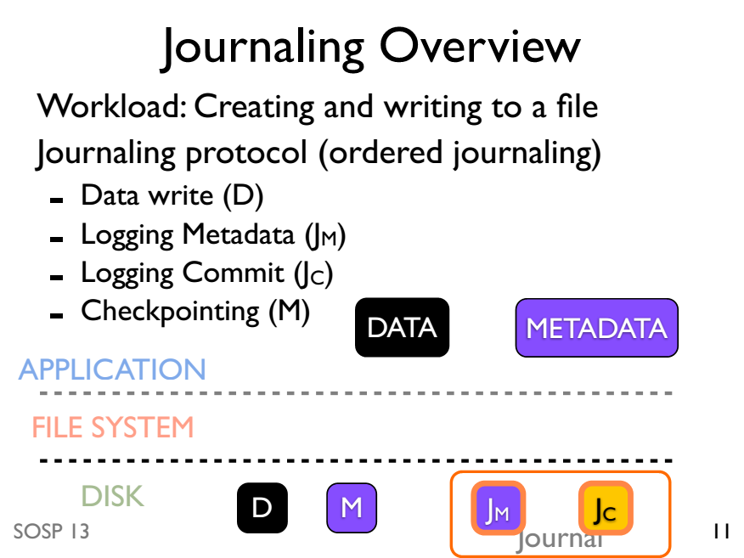

Slide 52
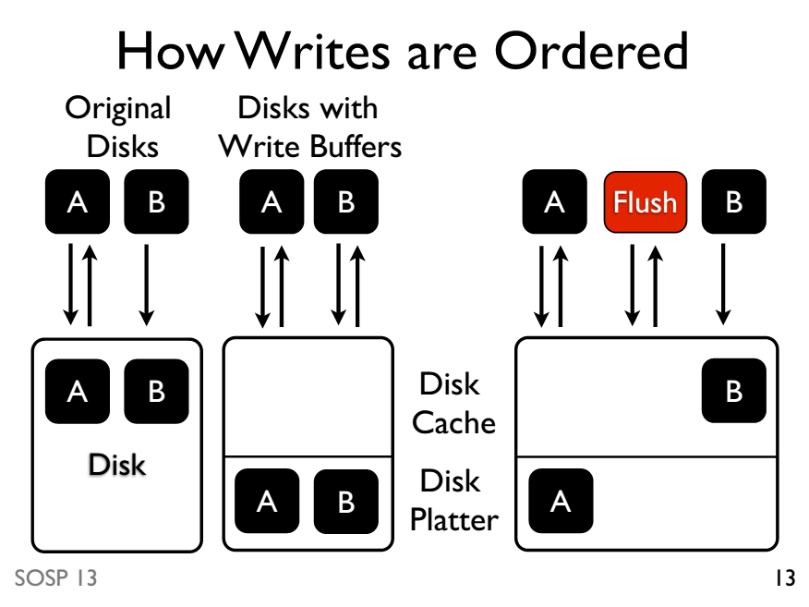

Slide 53
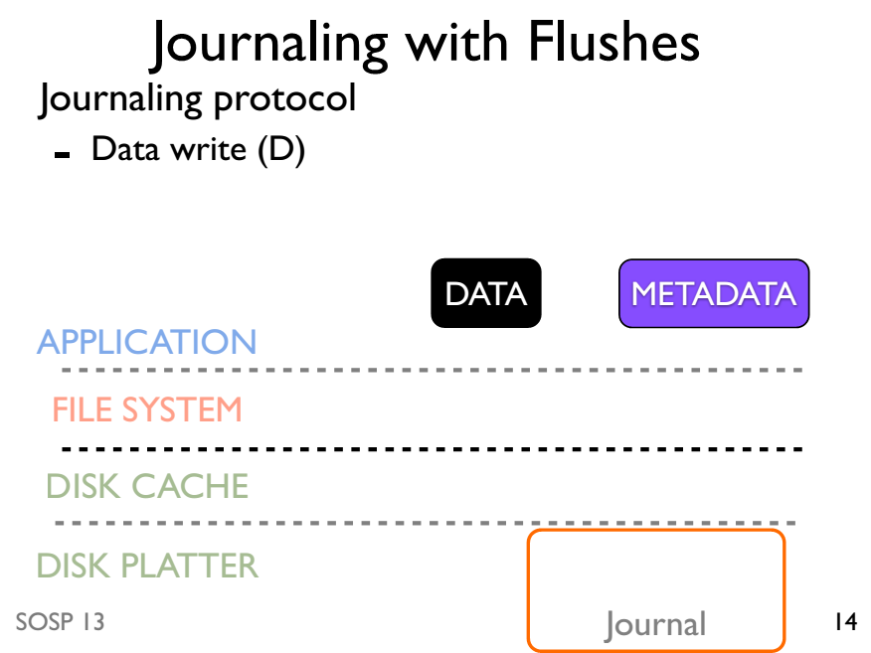

Slide 54
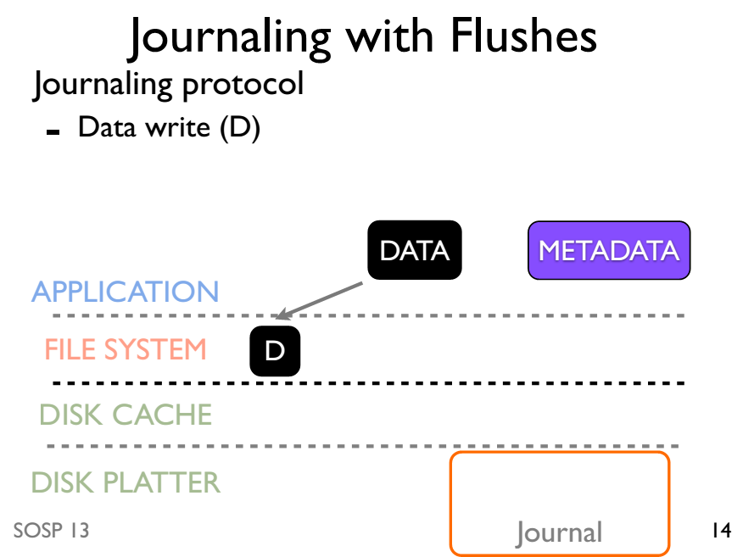

Slide 55
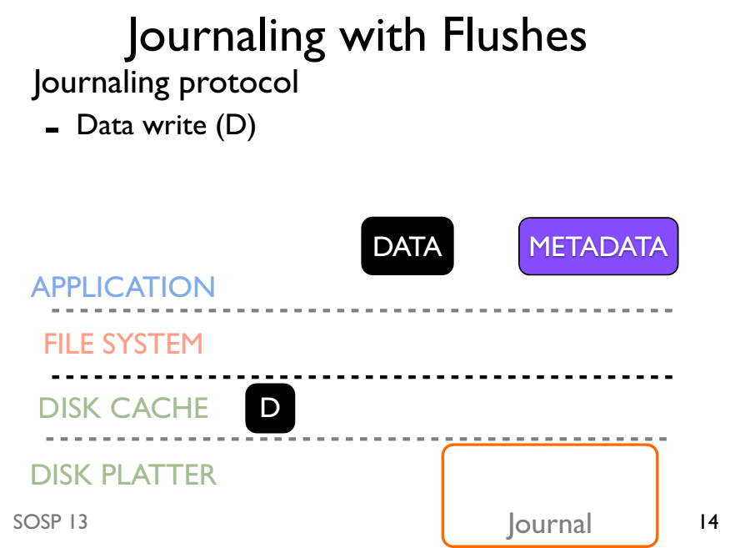

Slide 56
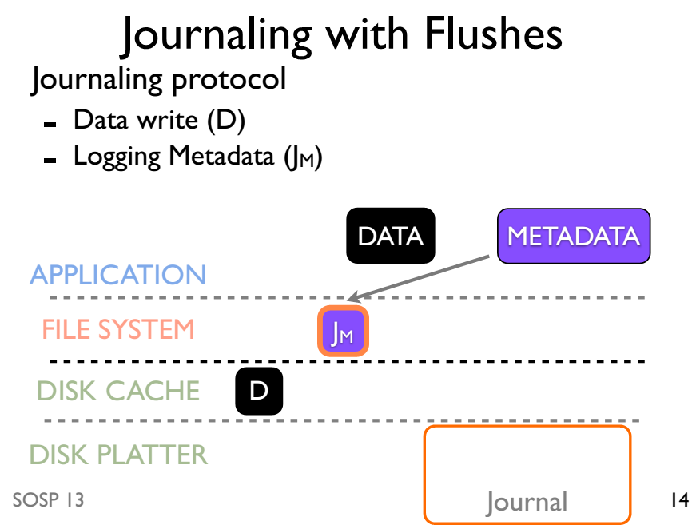

Slide 57
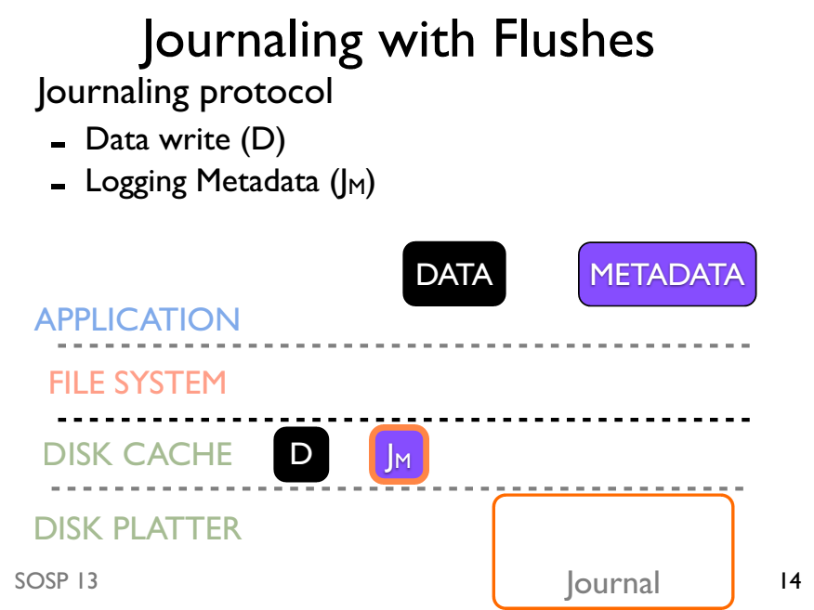

Slide 58
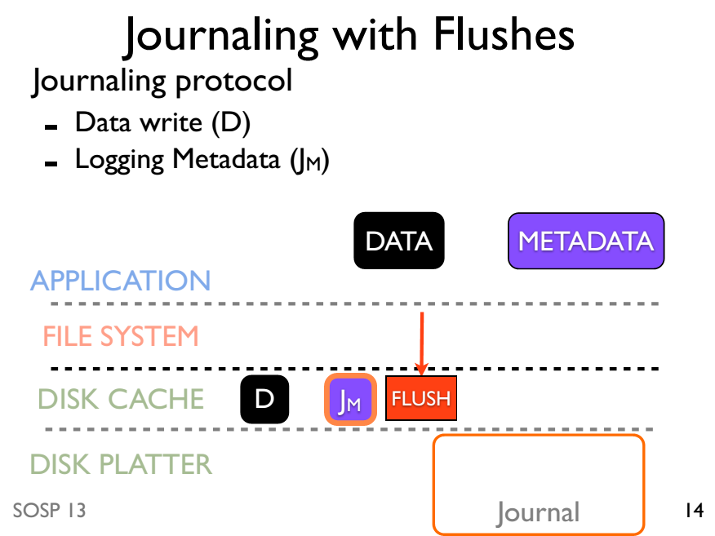

Slide 59
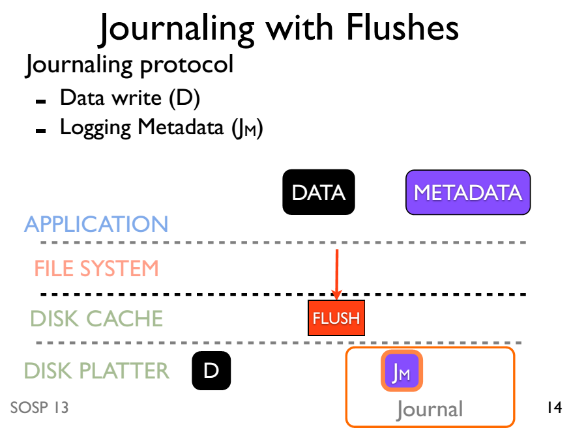

Slide 60
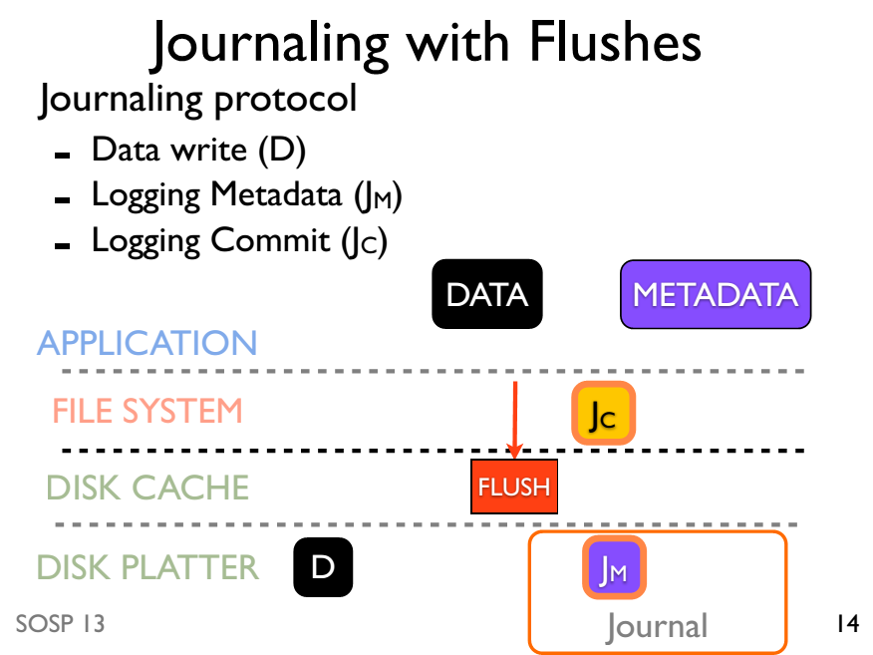

Slide 61
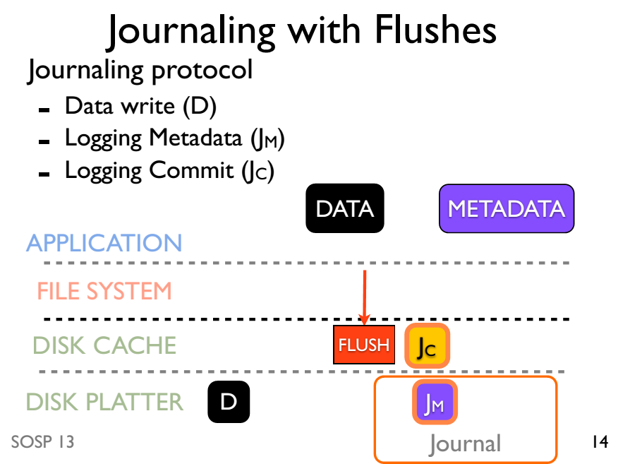

Slide 62
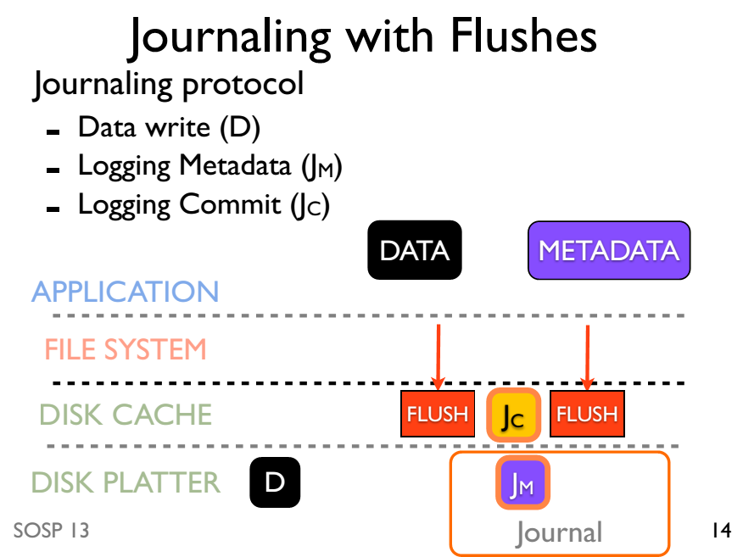

Slide 63
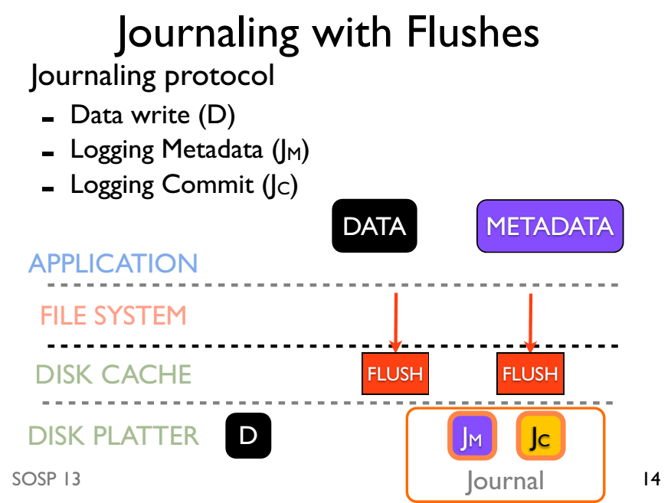

Slide 64
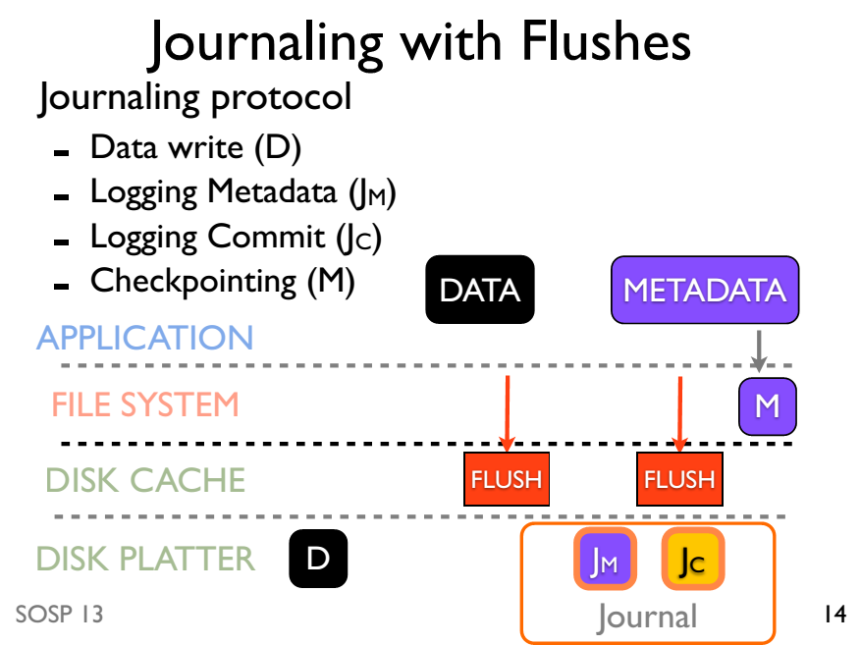

Slide 65
Journaling without ordering

Slide 66
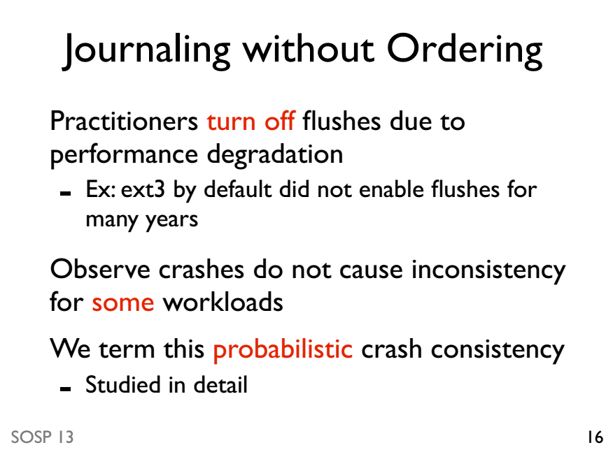

Slide 67
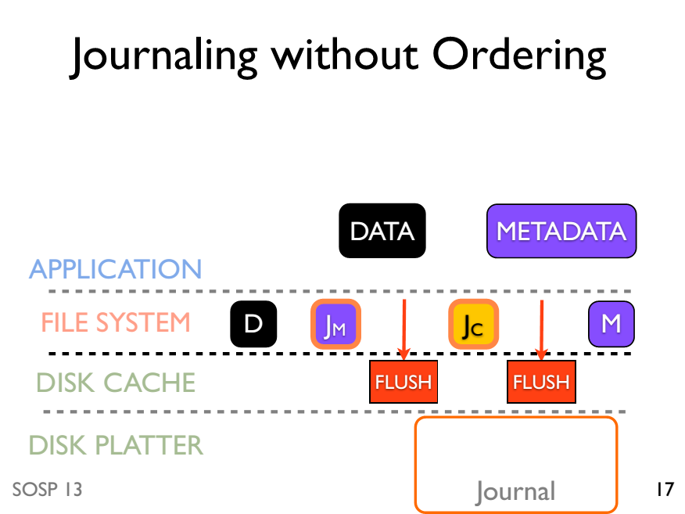

Slide 68
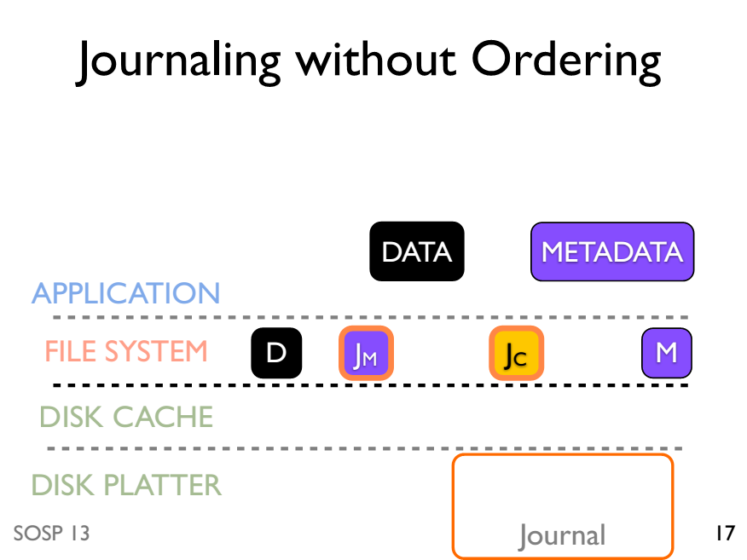

Slide 69
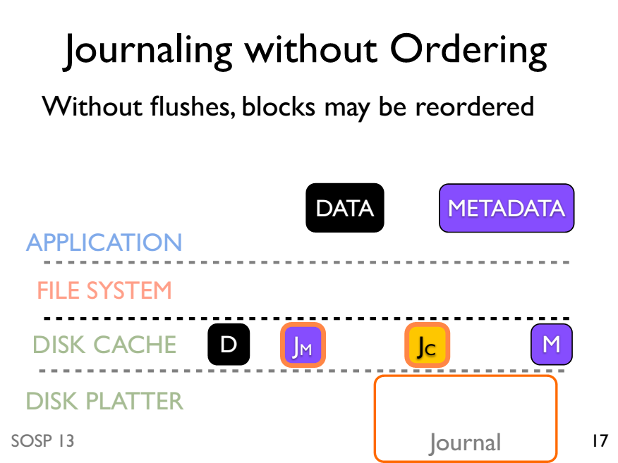

Slide 70
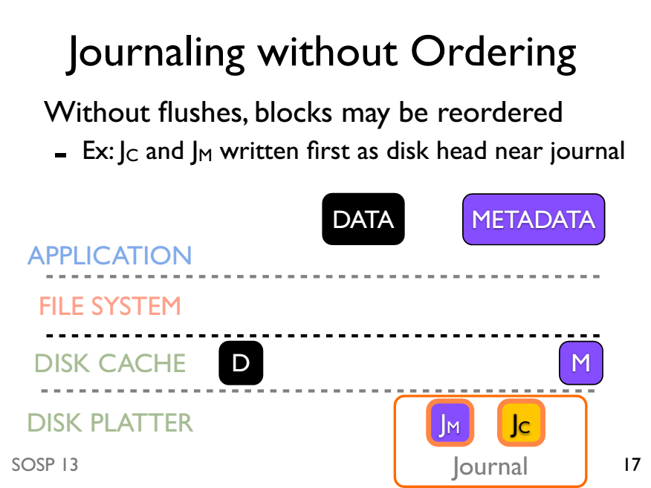

Slide 71
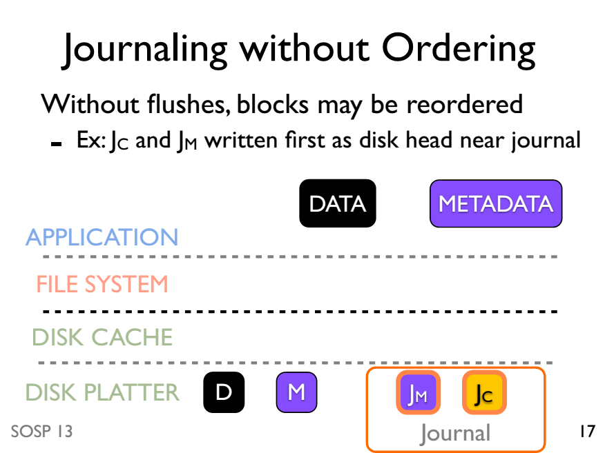

Slide 72
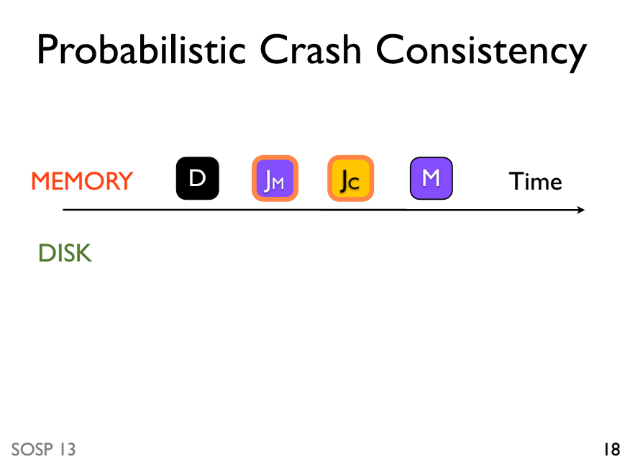

Slide 73
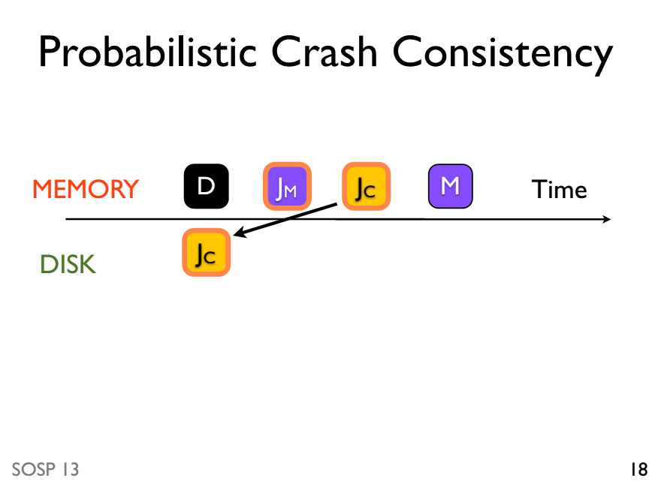

Slide 74
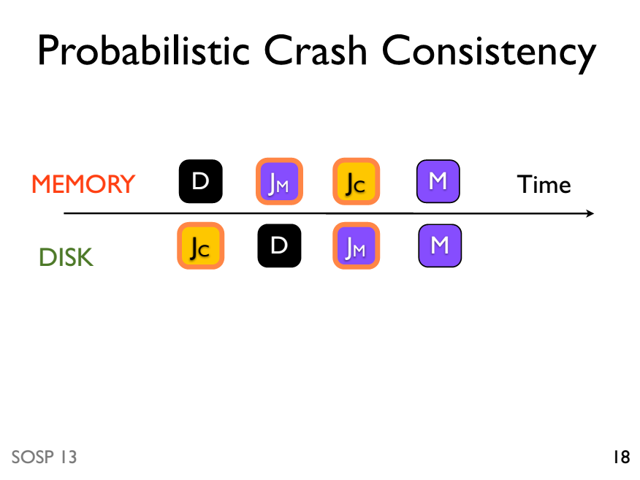

Slide 75
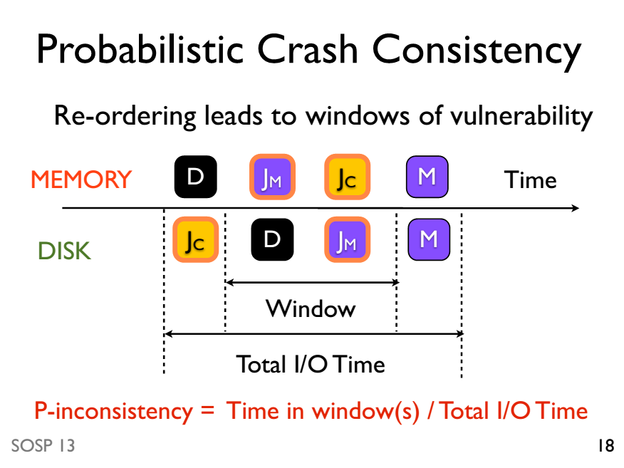

Slide 76
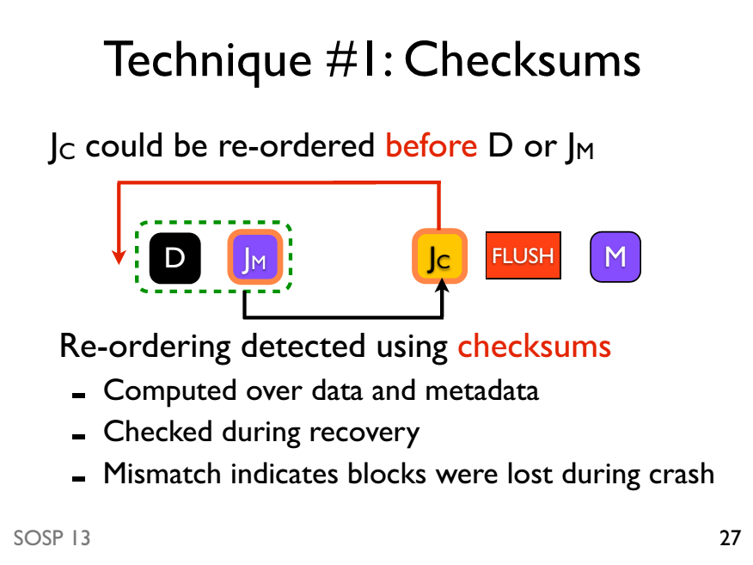

Slide 77
